Slide 1


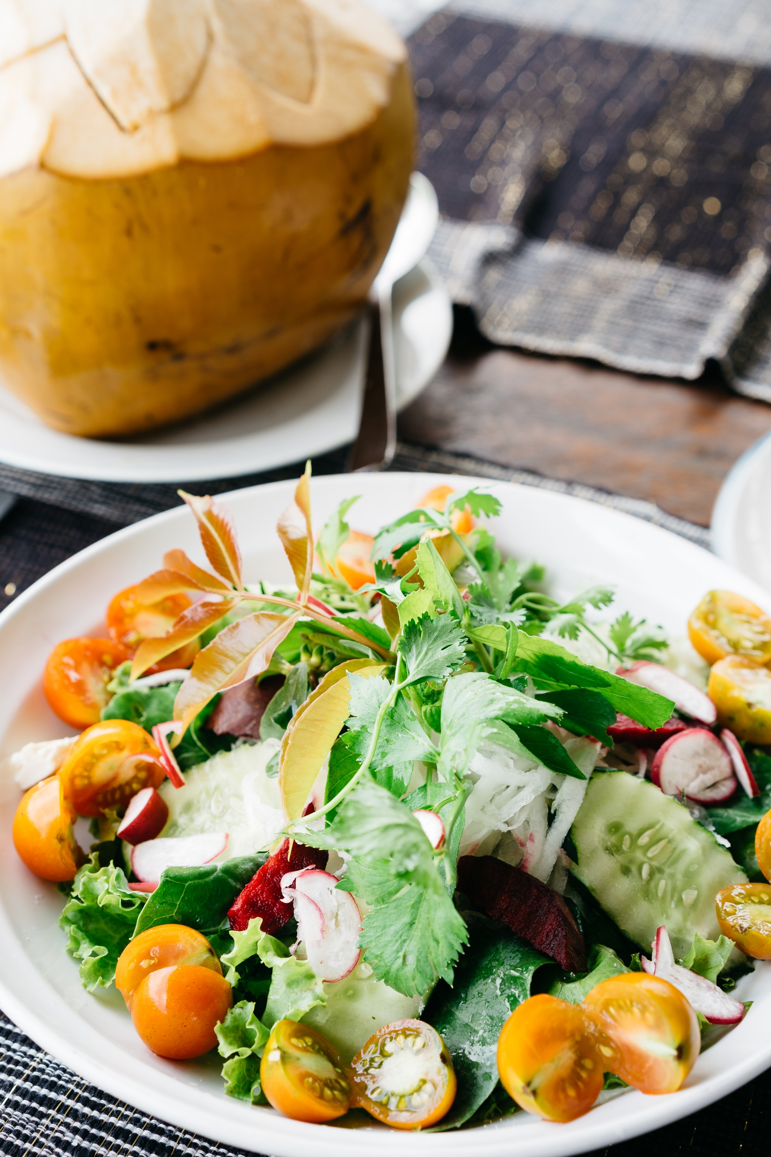
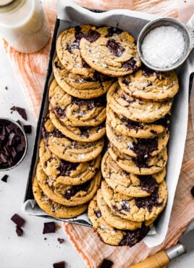
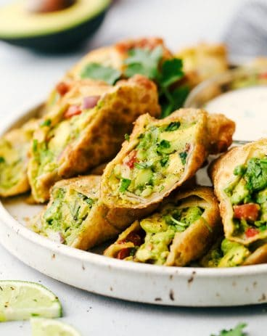
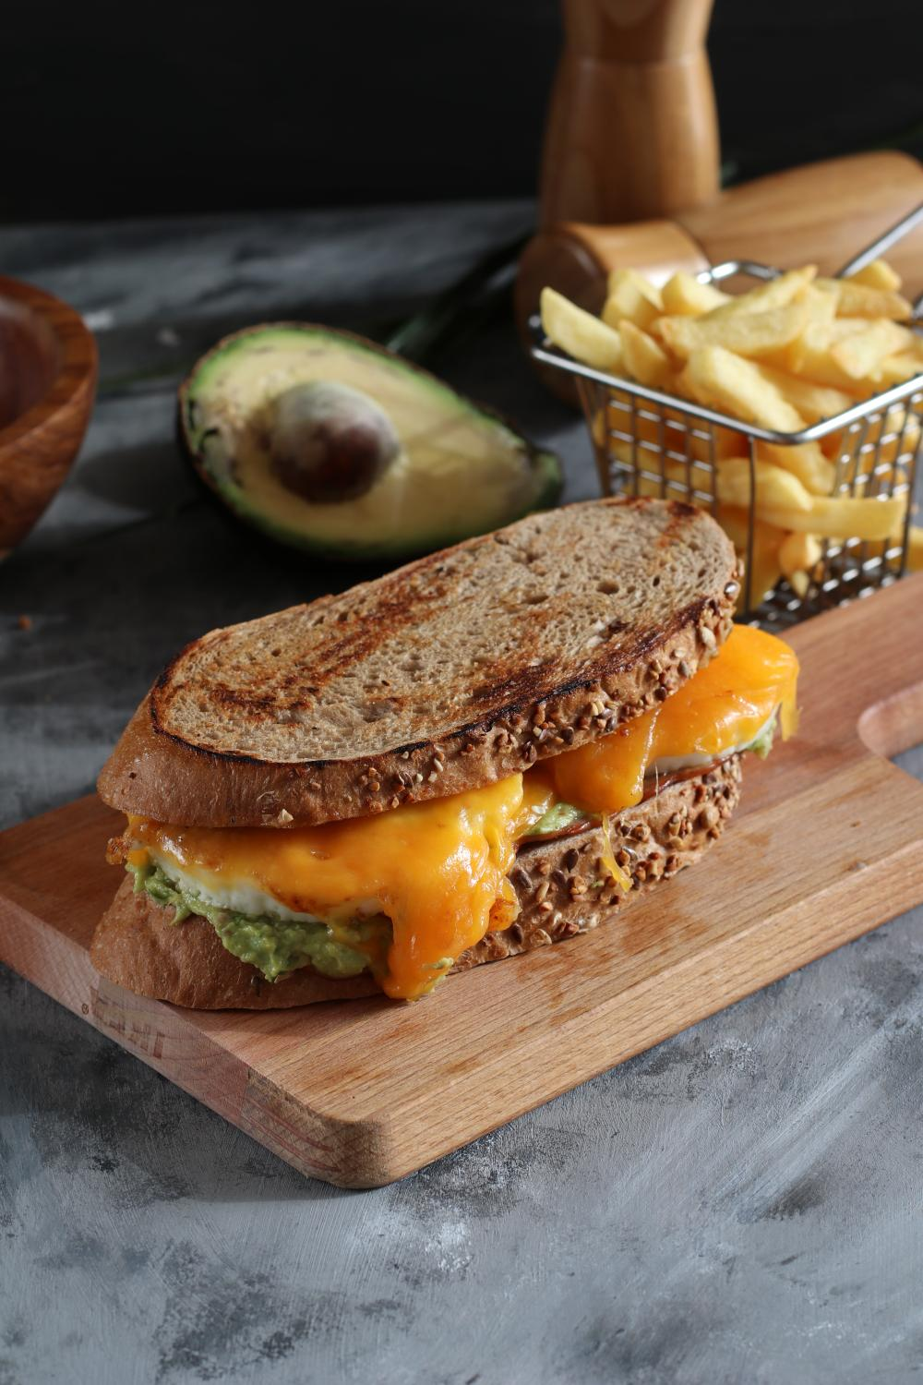


Search the site...
The Recipe Journal...
Home
Home
Recipes
Recipes
About
News
3.5k
Garlic Bread
Hot Chocolate
Dal Makhni
Salad
Dessert
Appetizer
Brunch

Slide 2
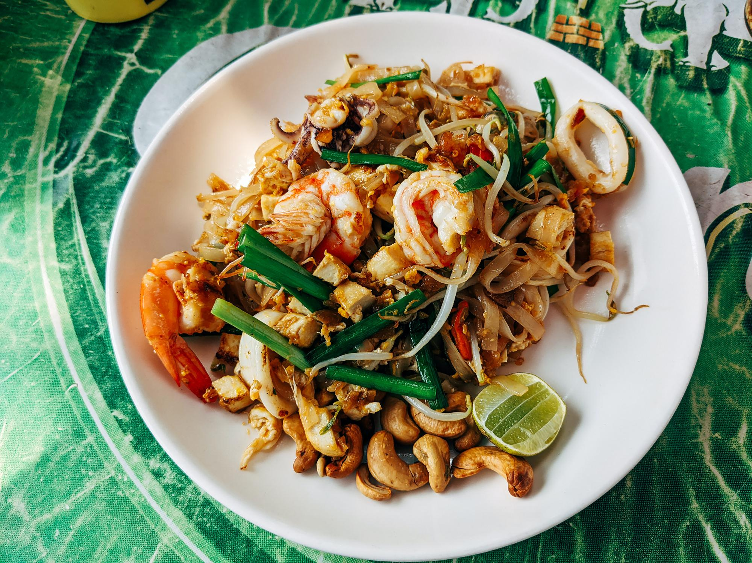
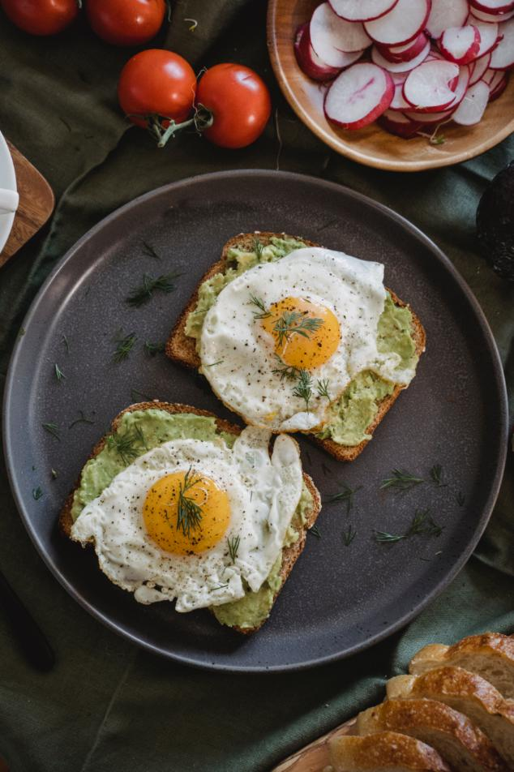
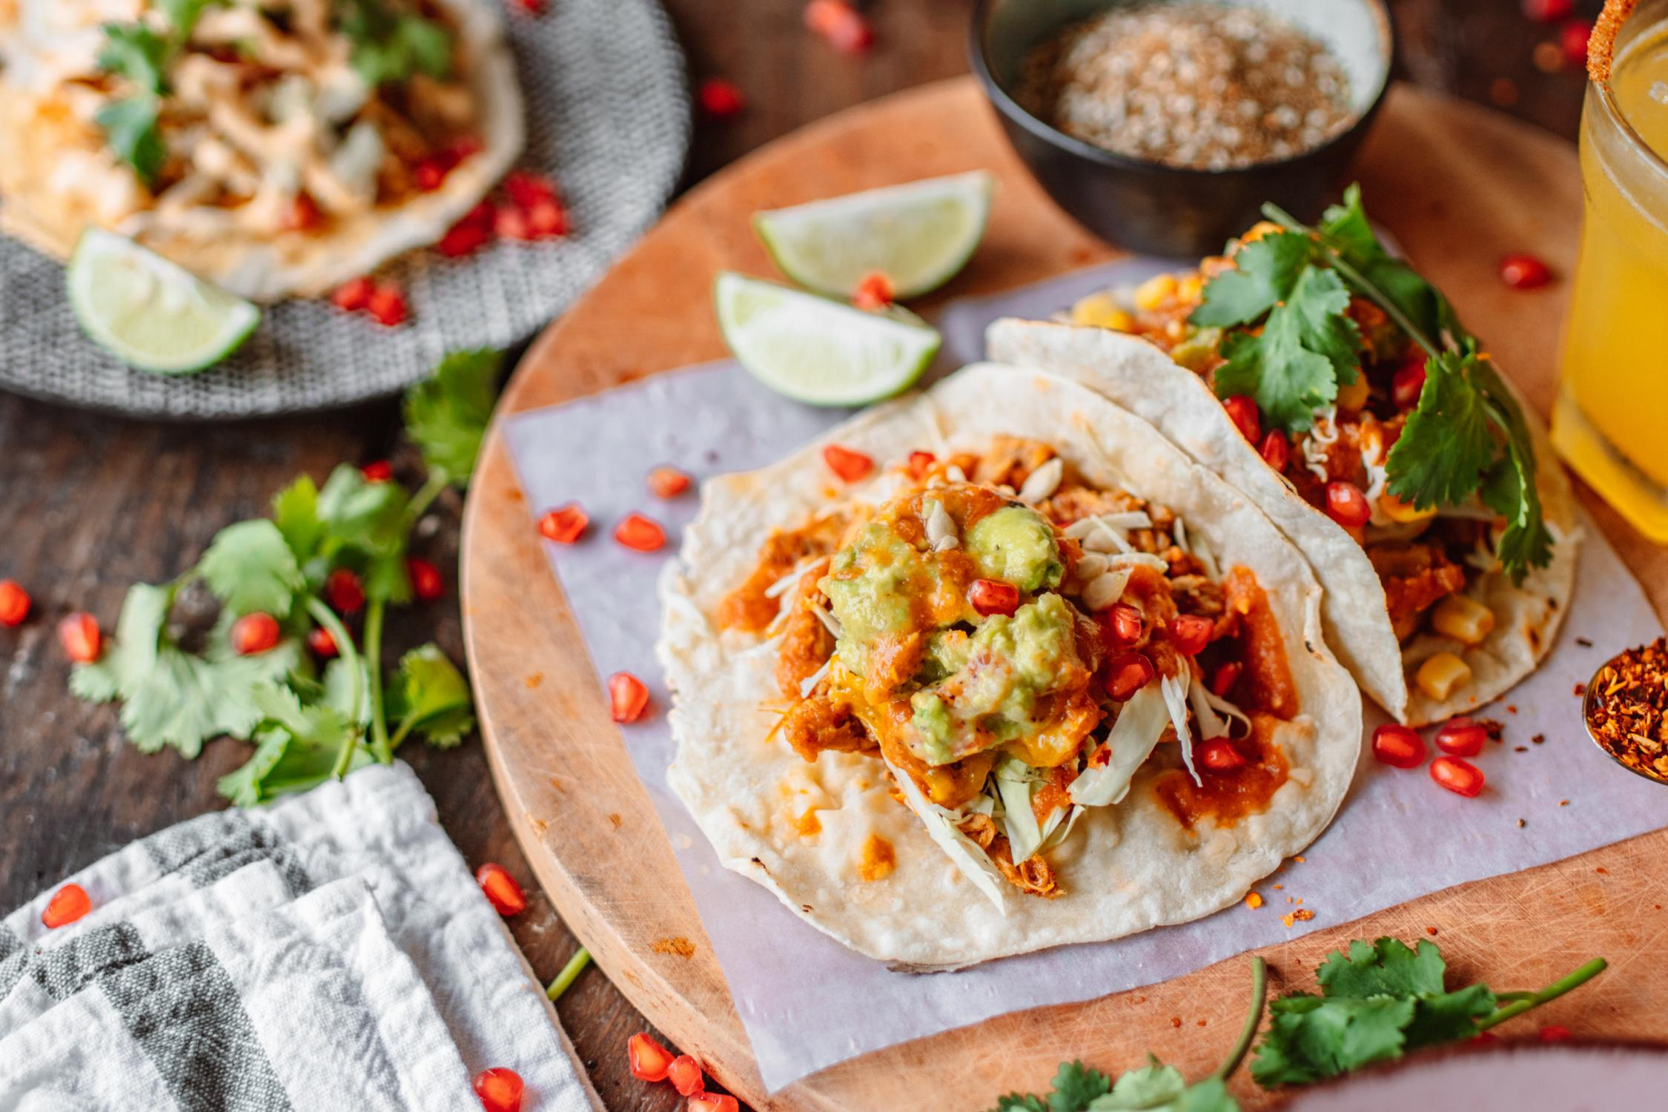
My Favourite Recipes
Snacks
Lunch
Veg Spring Rolls
Pad Thai Noodles
Dessert
These muffins use maple syrup instead of sugar, which make them less processed and contain more vitamins and nutrients.
Eggs provide fats and choline for brain and cognitive development.
Breakfast
Appetizer
Avocado Egg Toast
Chicken Tacos

Slide 3
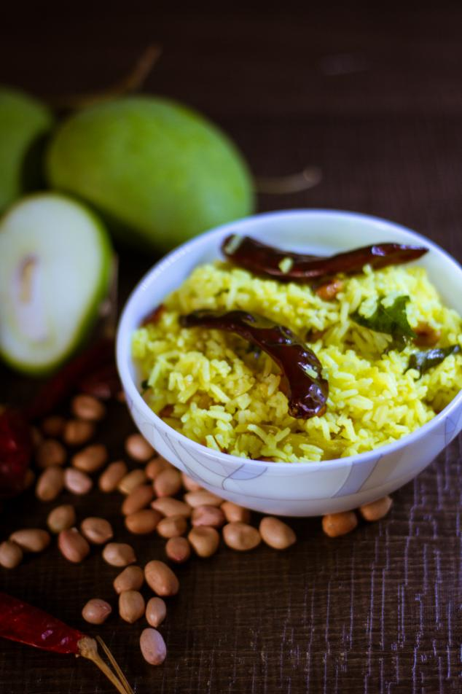
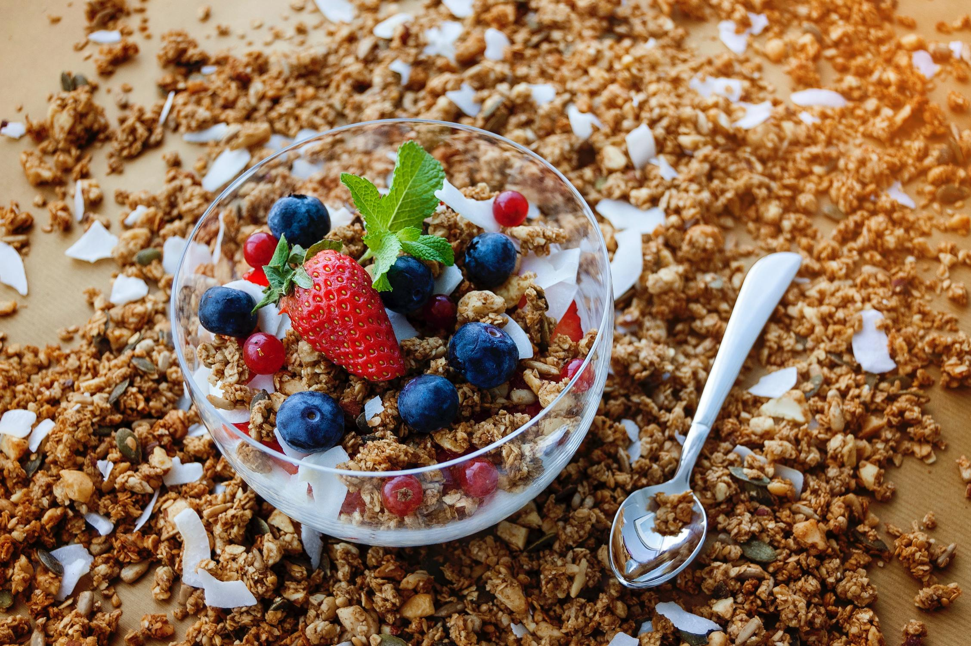
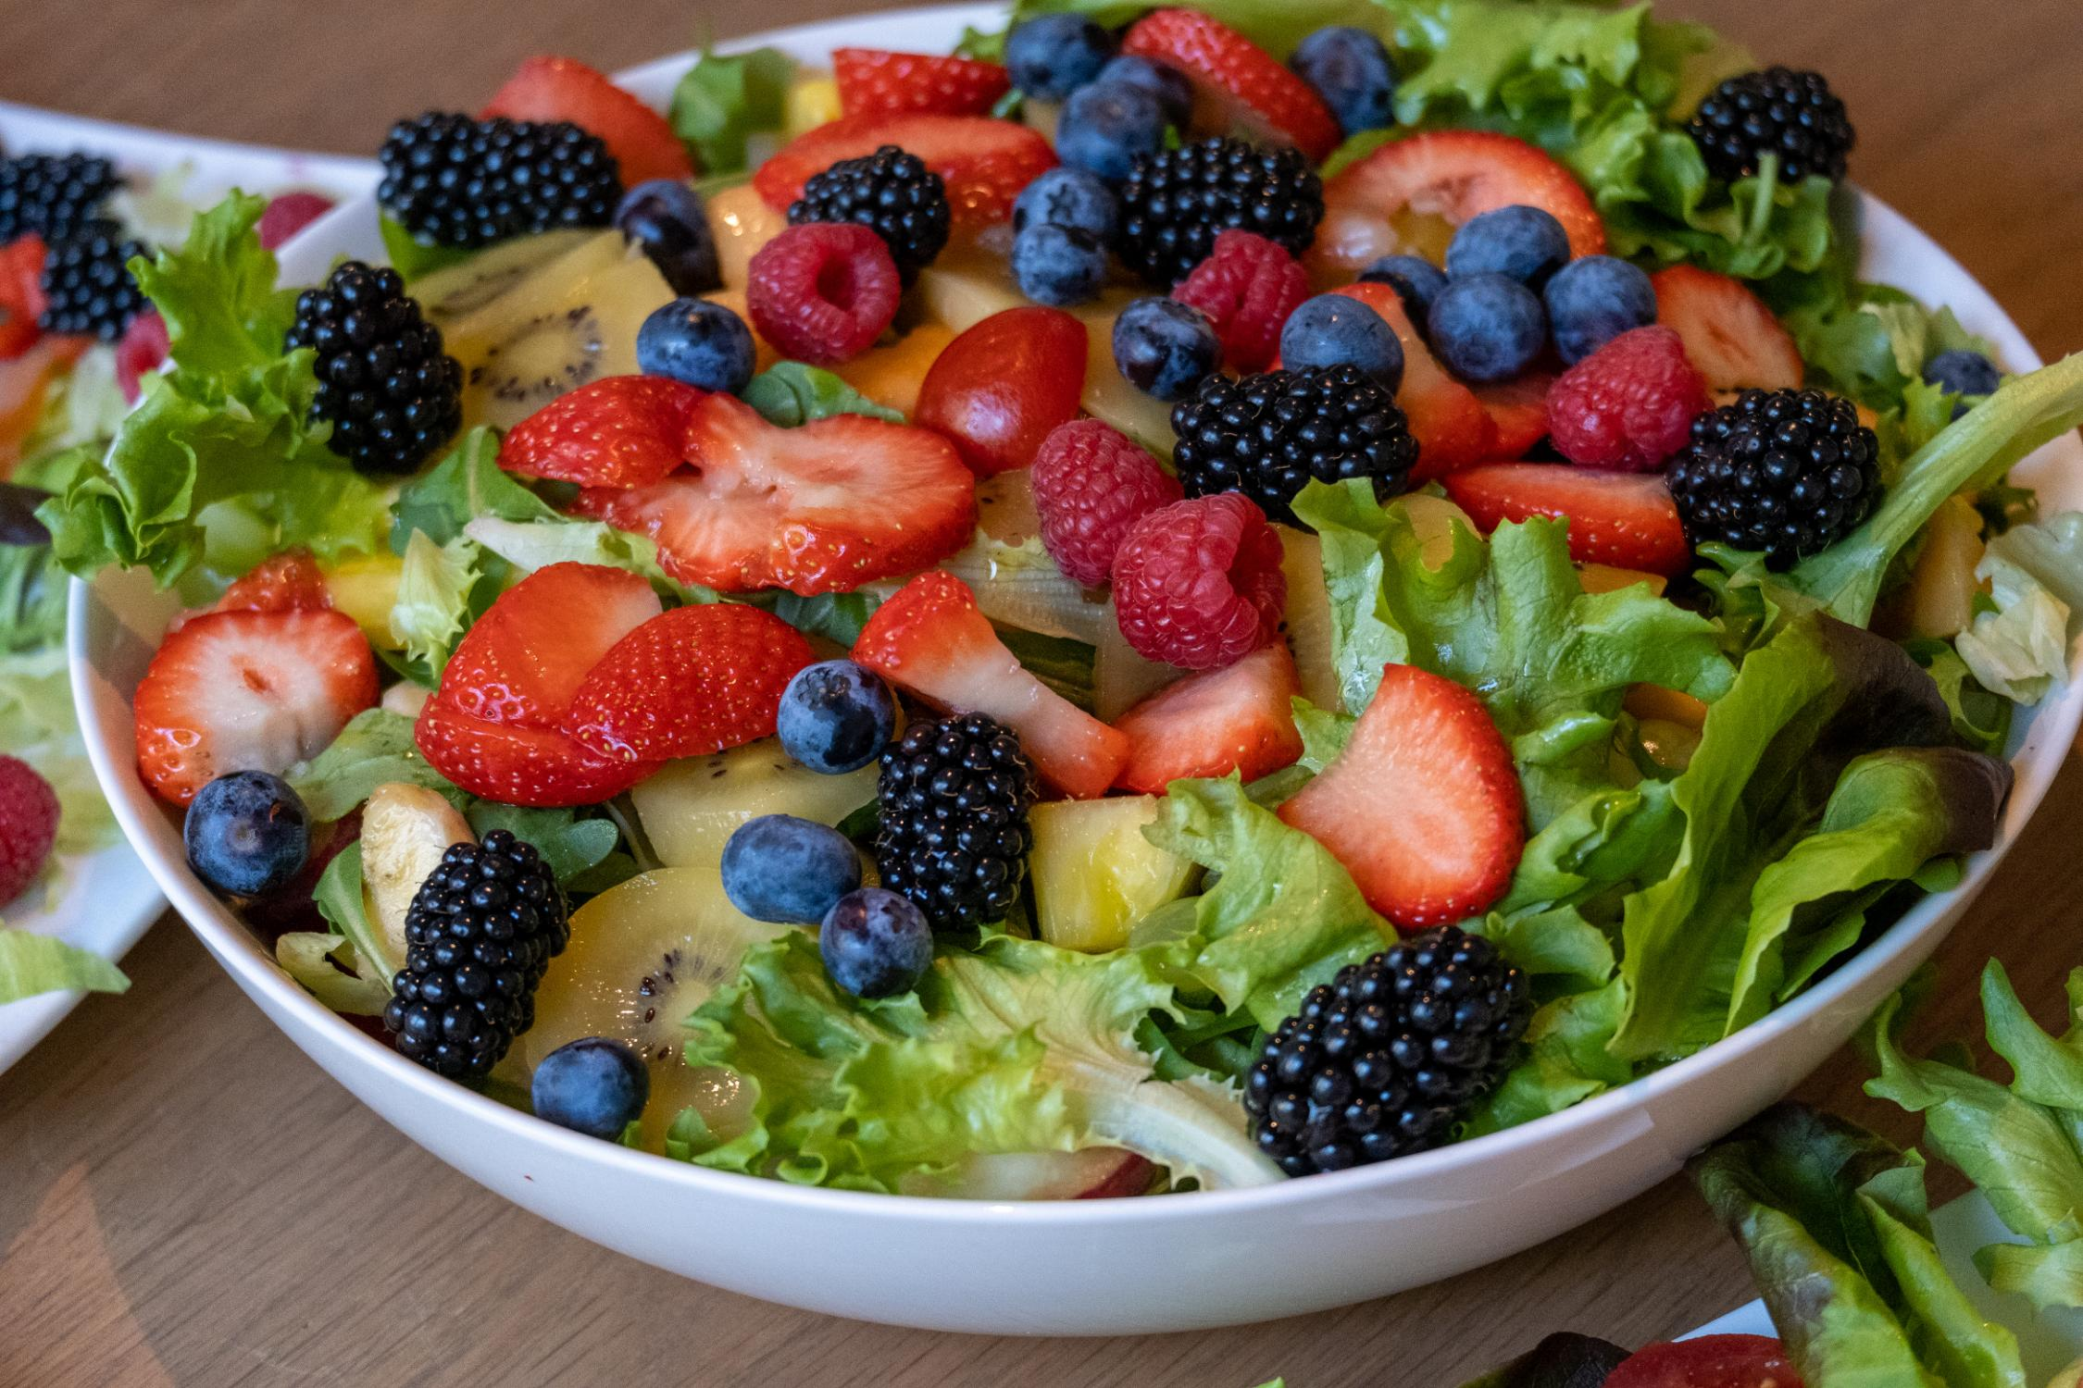
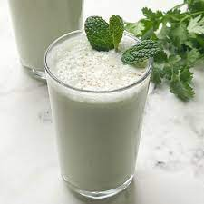



SUMMER DELIGHTS
View All Summer Recipes
Breakfast
Oats Bowl
Soup
Zucchini Soup
Salads
Appetizer
Rice
Fresh Fruit Salad
Avocado Egg Toast
Lemon Rice
10 mins
15 mins
Drinks
Masala Chaas

Slide 4
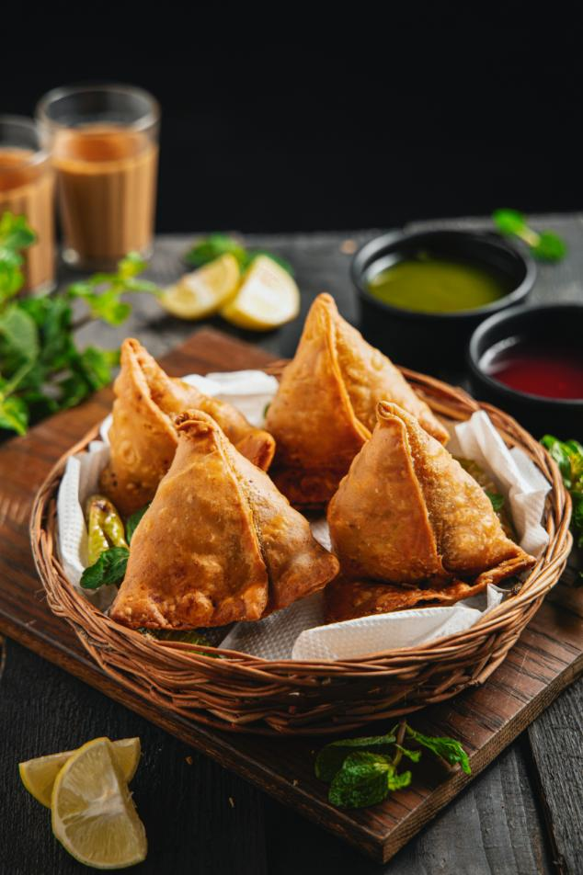
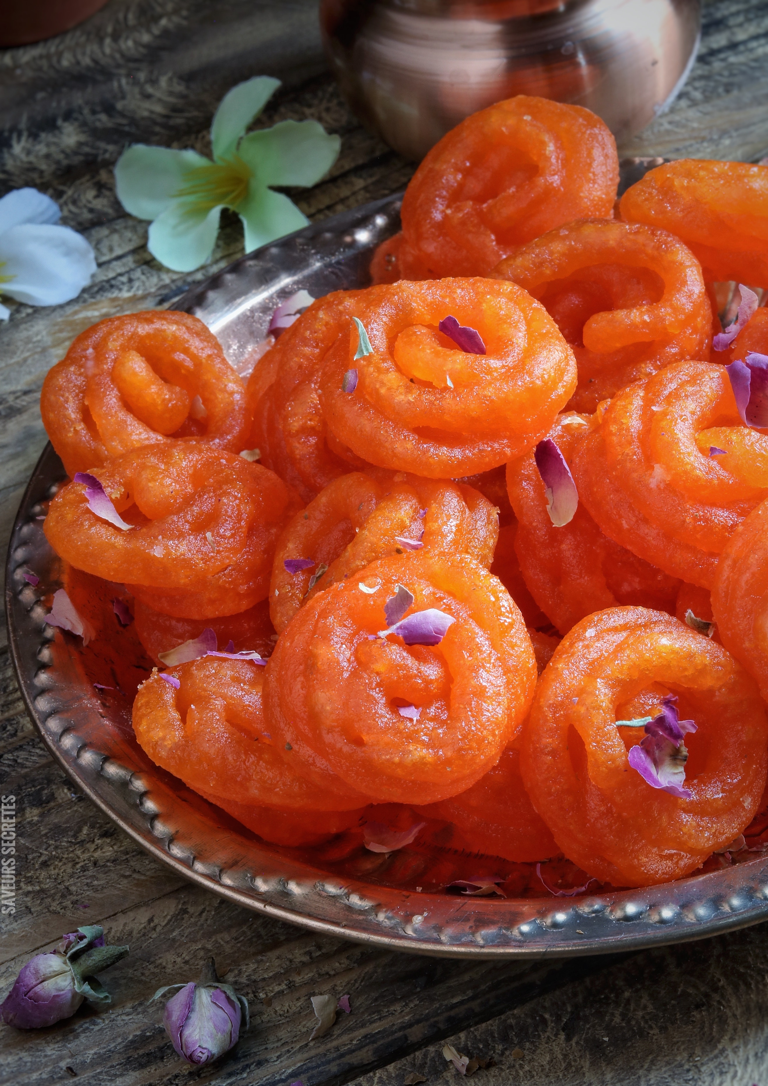
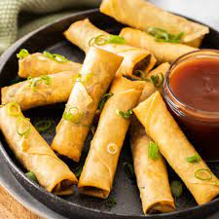
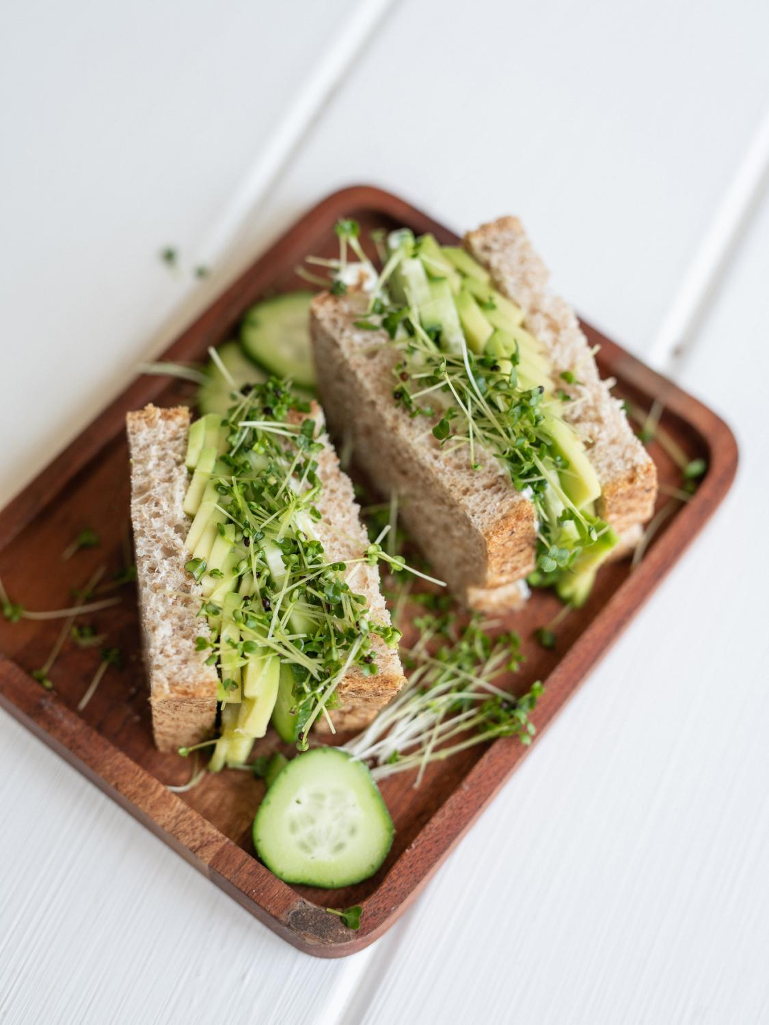

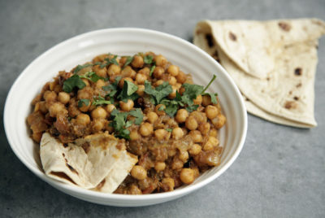
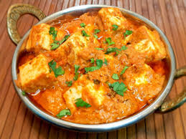
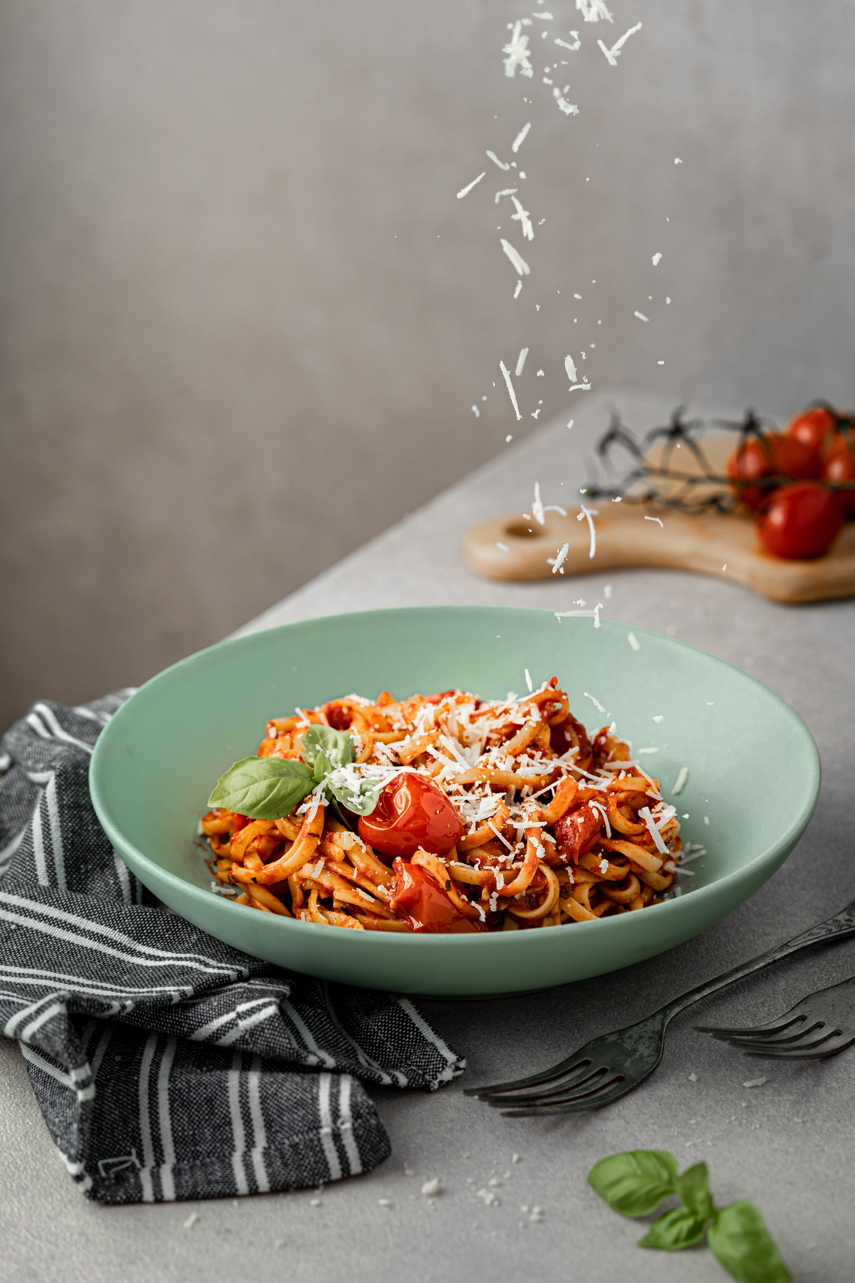
Snacks Recipes
View All Snacks Recipes
Snacks
Dessert
Appetizer
Dessert
Snacks
Samosa
Kesar Jalebi
Cheese Cigar
Banana Muffins
Cucumber Sandwichs
Easy Dinners
View All Dinner Recipes
Dinner
Dinner
Dinner
Pasta
Soup
Chicken Tacos
Channa Masala
Kadai Panner
Spaghetti
Zucchini Soup

Slide 5
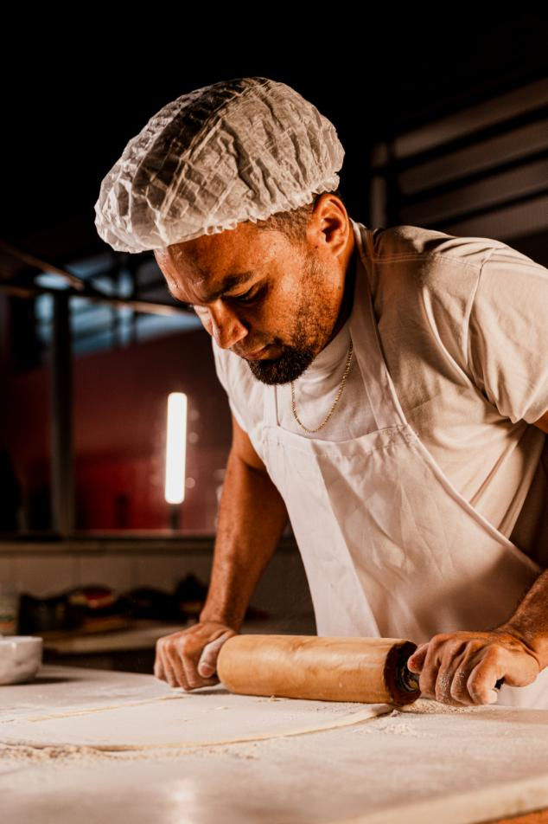
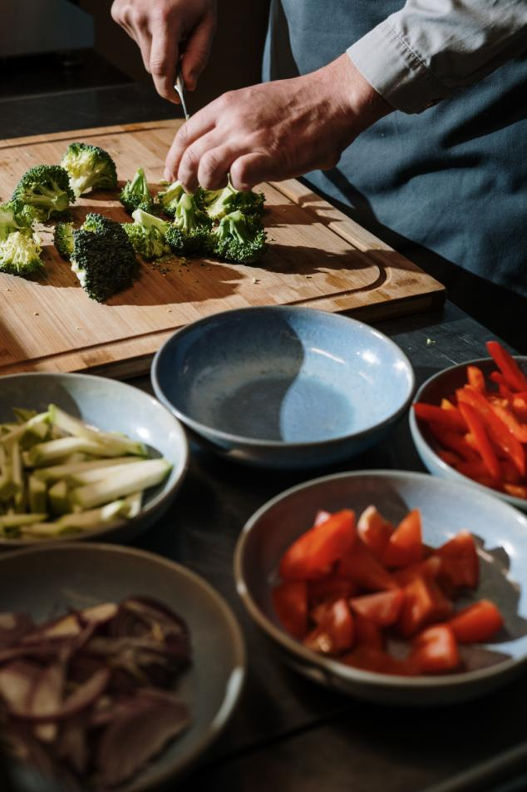
HI! I’M PRATEEK.
I am so excited to cook and bake with you. The recipes you’ll find here are simple, fresh, family friendly, and sometimes a little decadent.The kitchen is my happy place and the center of our home.
LEARN MORE

Slide 6
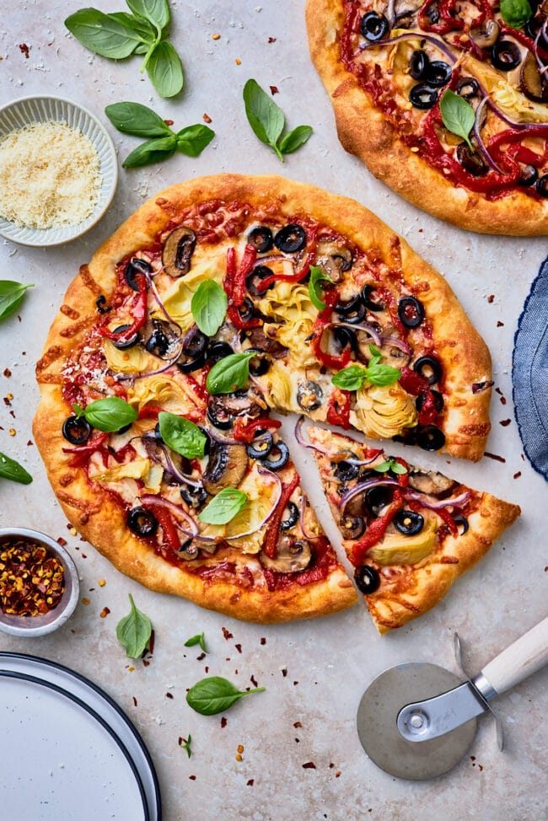
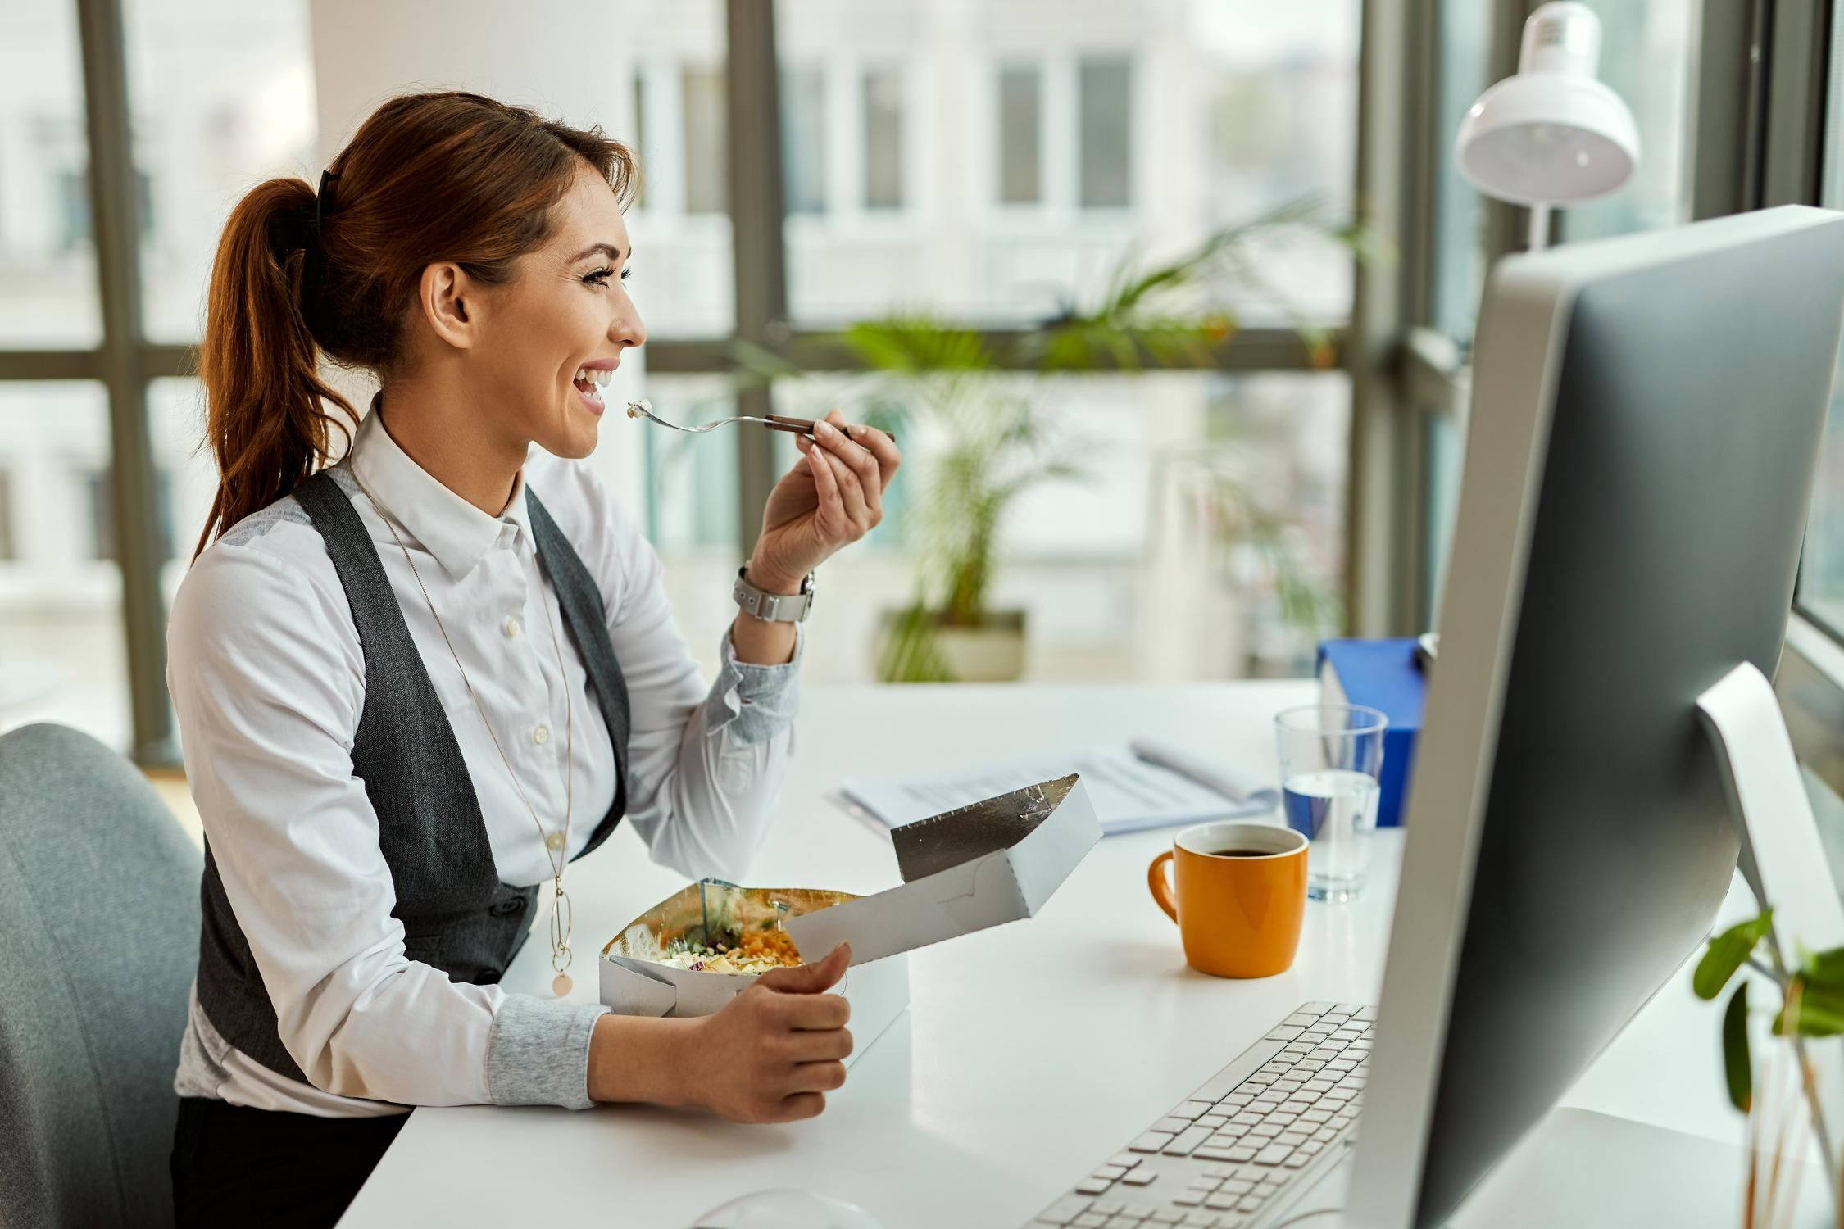
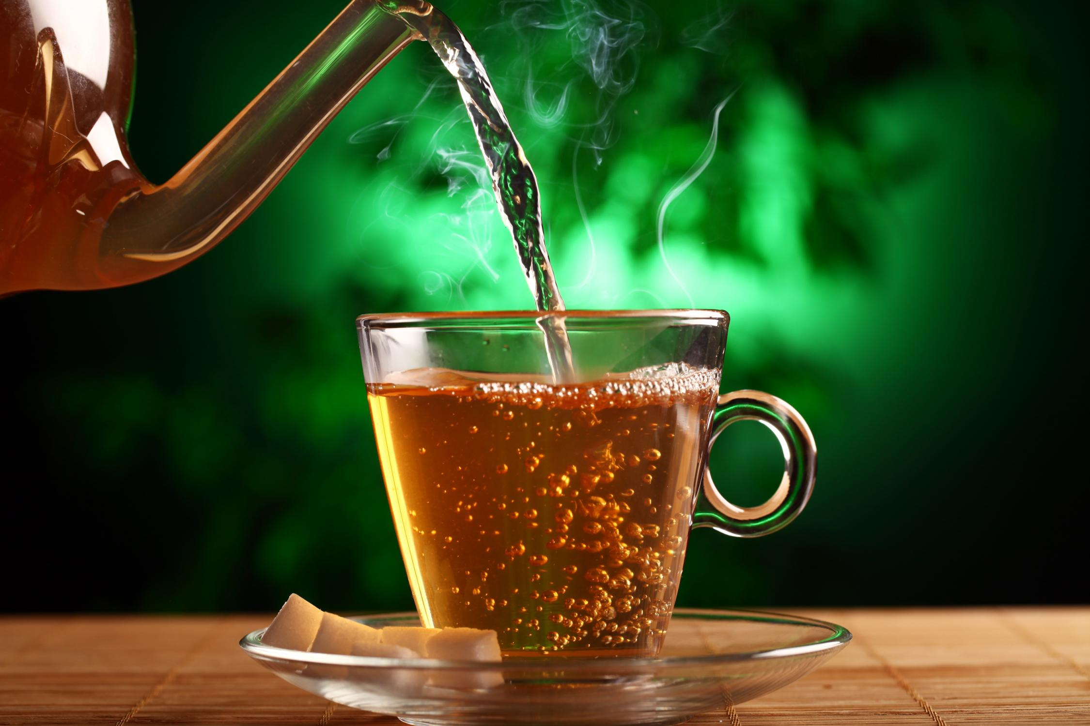



Latest News
John
20/05/21
John
20/05/21
John
20/05/21
John
20/05/21
John
20/05/21
20/05/21
John
20/05/21
Two Pizzaerias featured in the Top 50 Pizzaerias of India.
Two Pizzaerias featured in the Top 50 Pizzaerias of India.
5 Ready to eat foods makes life easier for working women.
How a handful of pistachios can help balance nutritional deficiencies
Begin Your Day With These Food Combos To Boost Immunity And Stay Fit
Two Pizzaerias featured in the Top 50 Pizzaerias of India.
Two Pizzaerias featured in the Top 50 Pizzaerias of India.
More
More
More
More
More
More

Slide 7
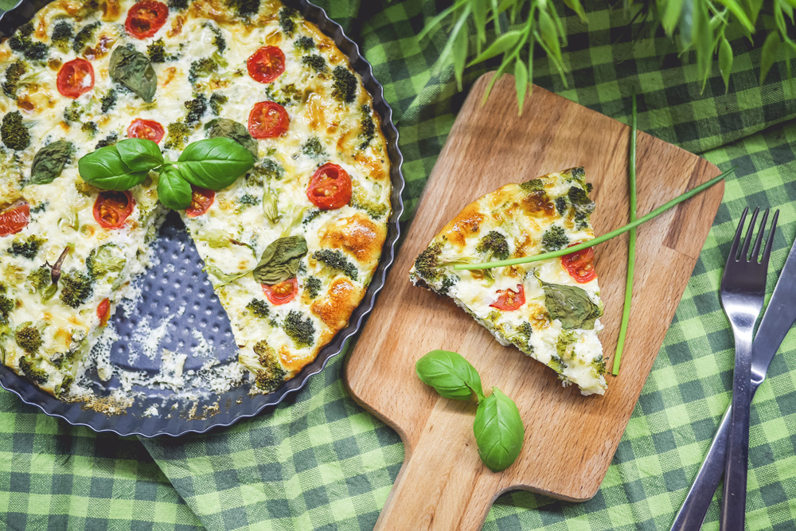
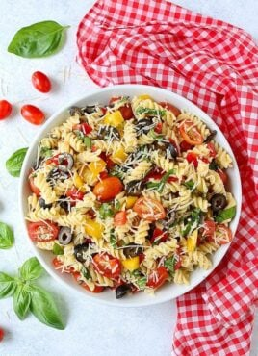





Recent Recipes
🍽 Lunch
🍽 Brunch
🍽 Desserts
🍽 Appetizer
Veggie Pizza Pie
Quick Pasta Salad
Peanut Butter Cookies
Spring Rolls
View More
Home
I hope you've enjoyed visiting my website. But before you go, why not check out my simple vegetarian recipes, my deliciously quick dishes or maybe even join me in the kitchen in my video recipes.
Recipes
Ready to Cook ?
News
About Us

Slide 8

Search the site...
The Recipe Journal...
Home
Home
Recipes
Recipes
About
News
Breakfast
Brunch
Dinner
Dessert
Drinks
Snacks & Appetizer
View All
Lunch
3.5k
Garlic Bread
Hot Chocolate
Dal Makhni
Salad
Dessert
Appetizer
Brunch

Slide 9
Home >> About
About Me
HI! I’M PRATEEK.
And FlowSnacks is my little corner of the internet!
I'm the voice, author, and creator behind Pinch of Yum. What started as a casual hobby over 10 years ago in 2010 while I was working as a fourth grade teacher has now grown into a full-blown business (!!) that reaches millions of people with fun recipes each month.
In this space, I am always sharing fresh, flavorful, (mostly) healthy recipes that I love to make and eat in my real, actual, every day life. If I wouldn’t eat it in real life, I won’t put in on the blog. My goal is to inspire you with food that is both approachable AND exciting, whether you’re cooking for yourself, your family, your roommates, or your friends. I want you to be so excited about these recipes that you eagerly await 5pm when you can go home from work and start cooking.

Slide 10
Write For Us
We are always on the lookout for new expert voices to join our team of recipe developers and writers. Please submit pitches along with three examples of your published work (print or online) and a brief bio to write@simplyrecipes.com.
We accept pitches for recipes, how-tos, tips, and technique-driven posts.
We do not accept pitches for travel writing, restaurant reviews, or dining out stories.
Please review our site before pitching us.
Follow us on Social Media
Like FlowSnacks on Facebook
Follow @flowsnacks on Instagram
Follow @flowsnacks on Twitter
Follow @flowsnacks on Linkdin
Follow @flowsnacks on Pinterest

Slide 11
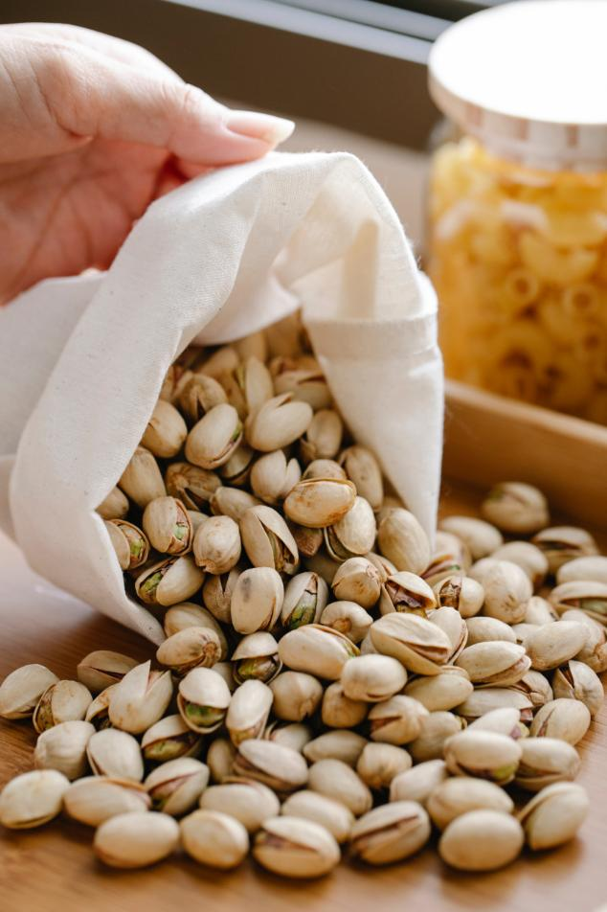
Home >> News
How a handful of pistachios can help balance nutritional deficiencies
Pistachios are an integral part of Indian cuisine. From the green velvety Pista Murg to the crunchy pista shavings on desi mithais, pistas are quite popular as an ingredient.
Pistachios contain a decent amount of iron, a mineral essential for carrying oxygen throughout the body. Including pistachios in your diet can help combat iron deficiency, preventing conditions like anemia and promoting healthy blood production.
Pistachios are rich in magnesium, a mineral that supports over 300 biochemical reactions in the body. Magnesium deficiency can lead to muscle weakness, fatigue, and even heart rhythm abnormalities. A handful of pistachios can provide a significant boost in magnesium intake to help address such deficiencies.
It's important to note that while pistachios can contribute to managing deficiencies, they should not be relied upon as the sole solution. If you suspect a deficiency or have any health concerns, it's best to consult with a healthcare professional who can provide personalized guidance and recommend appropriate interventions. With the right balance and variety in your diet, these little green wonders can play a tasty role in helping manage deficiencies and promoting overall well-being!

Slide 12
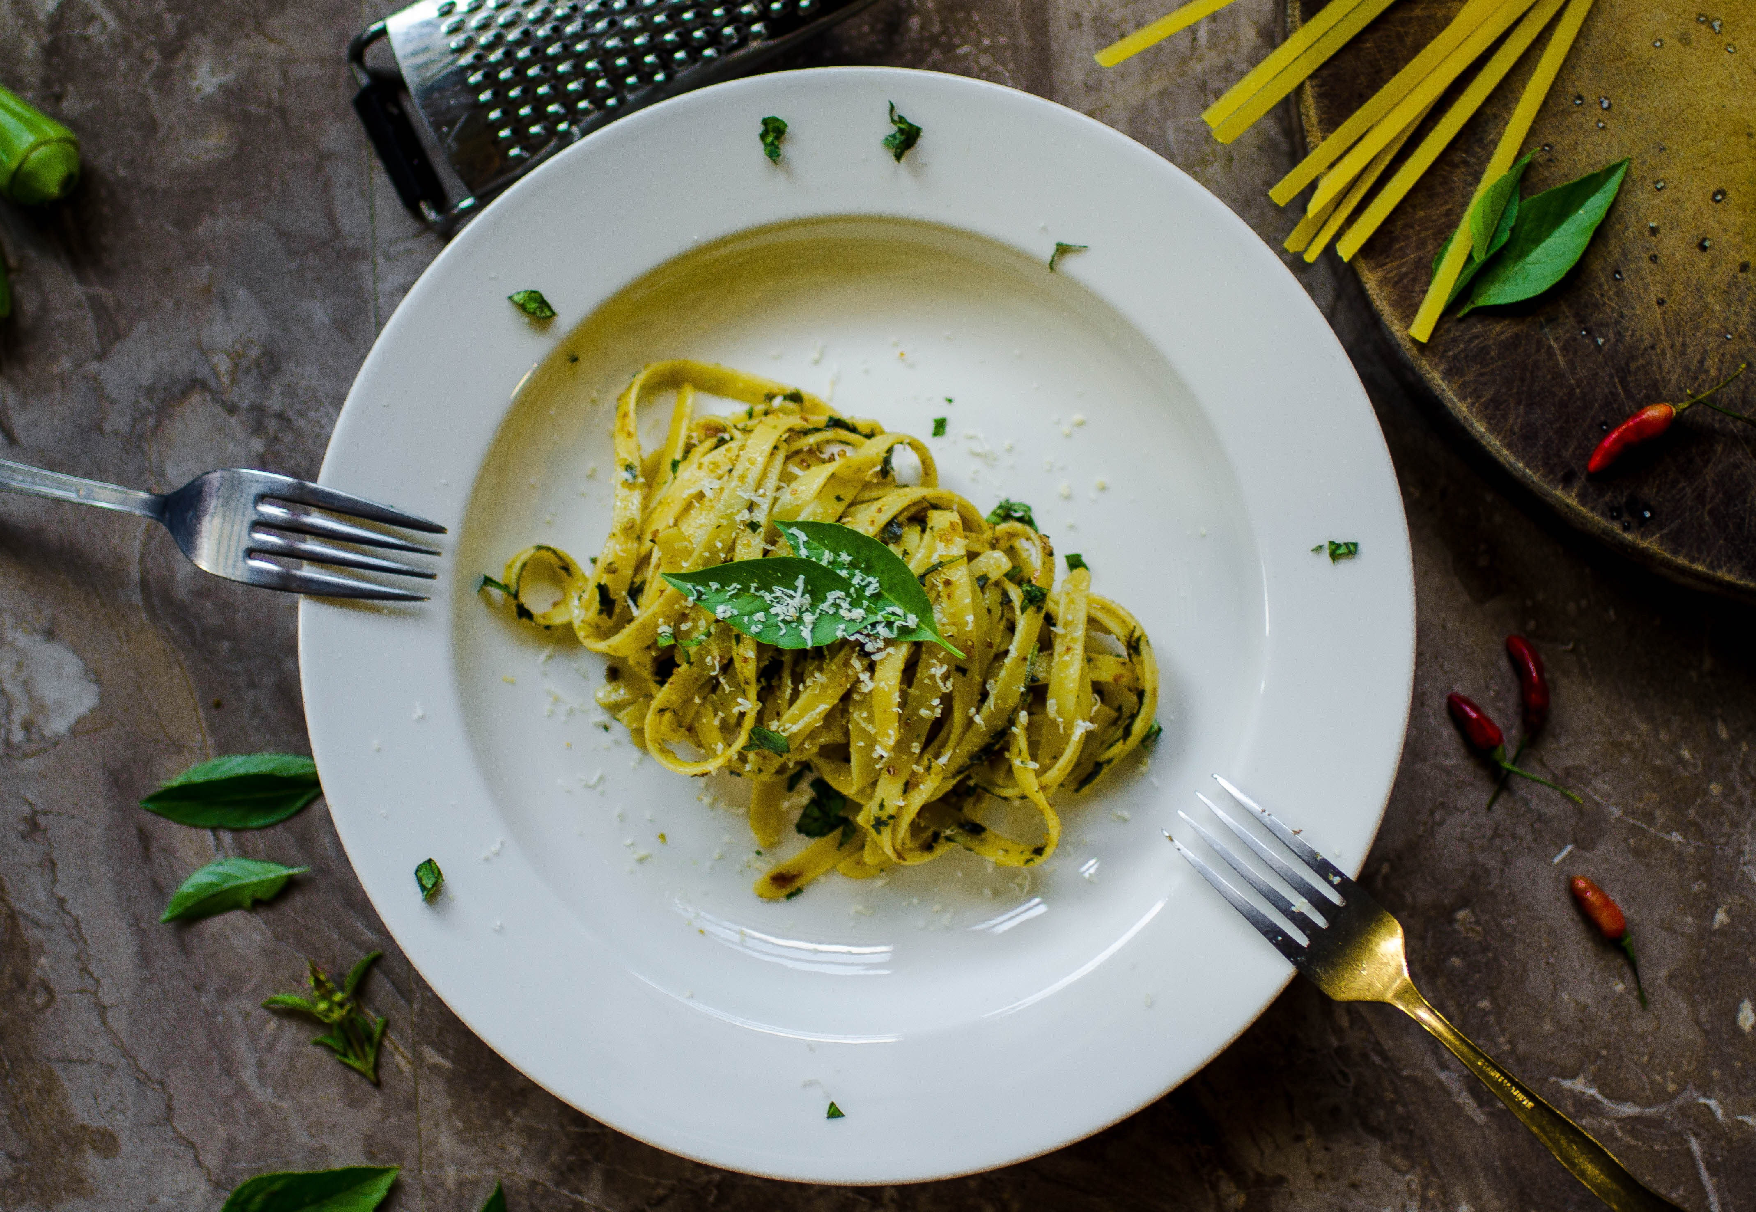
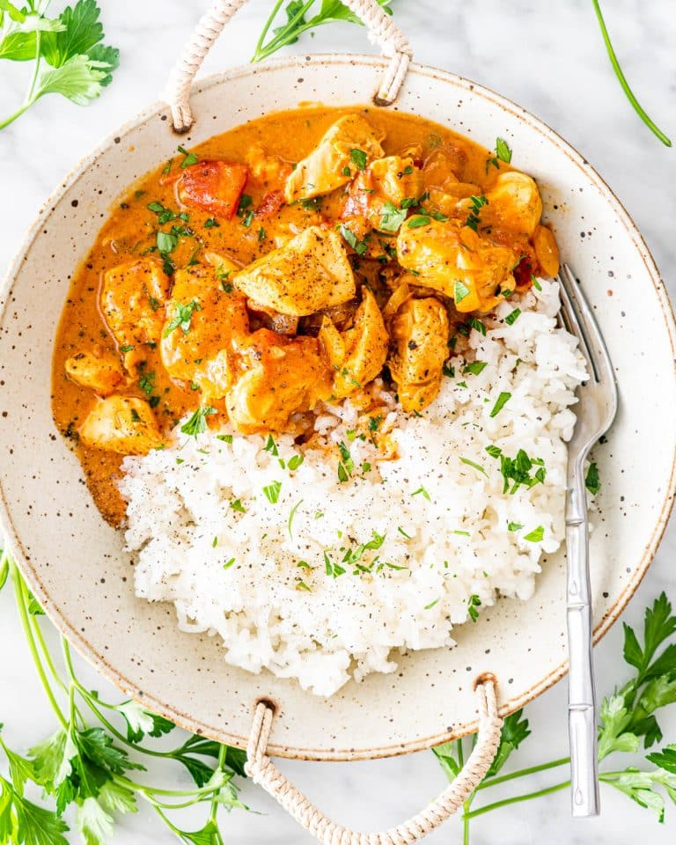
Home >> Recipes >> Dinner Recipes
Dinner Recipes
Dinner
Bring this easy 5-ingredient
spagetti in pesto sauce to
your dinner table.
John
30 mins
Dinner
Dinner
Creamy Coconut Chicken
Curry enriched with coconut
cream.
Masaledar Channa Masala
will uplift your taste buds.
John
John
30 mins
30 mins

Slide 13
Home >> Recipes >> Dinner Recipes >> Parsley Pesto Pasta
Dinner
Parsley Pesto Pasta
Jump to Recipe
This recipe will have you saying hasta la pasta to all the other pasta recipes out there! Okay well… maybe except for some of these other all time favorites: Asiago Garlic Alfredo Pasta and Alfredo Pesto Tortellini with Sausage.
Parsley Pesto Pasta
Let’s be honest, you cannot go wrong with pesto, especially when there are noodles involved.

Slide 14
What is Parsley Pesto Pasta ?
One of my favorite recipes that I have done is my basil pesto. I loved the way it turned out so I thought it would be fun to try something a little different with parsley pesto. A very helpful tip I discovered is that when I did this dish I found that using a flat leaf of parsley really helps make the sauce balanced so that the flavor of the nuts, olive oil, and parmesan are all tied together.
You will love the taste of this sauce over pasta noodles! But it is so good that you won’t just stop there.. It is also the perfect addition to have over grilled veggies, as a pizza sauce, or even a sandwich! Because of how compatible this sauce is, you can pair it with just about anything.
What do you need to make Parsley Pesto Pasta ?
This recipe is perfect for summer! It calls for minimum ingredients but still has quite the flavorful taste. And everything that is included is mainly your normal go to ingredients that you either have on hand or are very easy to come by! Here is a list of exactly what you need to create this dish:
Spaghetti- these are the noodles I prefer to use for this recipe but you can also switch it up and use fettuccine noodles, your favorite noodles, etc.
Unsalted, roasted almonds- The nuts really help bring the flavor of the parsley out and tie the other ingredients together
Fresh flat-leaf parsley leaves- The fresher they are, the better. These are the main source of flavor that makes this dish a hit!

Slide 15
Chopped fresh chives- Helps give a little bit of kick and a refreshing taste
Extra virgin olive oil- Helps balance the nuts, parsley, and parmesan
Finely grated parmesan cheese- Because what is pasta without parmesan
Freshly ground pepper- Add to taste
Kosher salt- Also add to preferred taste
How do you make Parsley Pesto Pasta
One of the reasons why this meal is so good, is because you can achieve a delicious dish with minimal effort! This recipe is so easy to quickly throw together that you’ll wonder how many times it is acceptable to make this in a week. Here are the simple steps you need to follow to recreate this pasta:
Cook pasta. Let the pasta cook in a large pot until al dente. Then make sure to rinse the noodles very well in cold water so that they no longer stick together. Also reserve 2 cups pasta cooking liquid.
Pulse the almonds in a food processor until smooth. Add parsley, chives, oil and parmesan. Process until smooth. Season the pesto with salt and pepper.
Toss pasta and pesto in a large bowl. Add the reserved pasta cooking liquid by ¼ cupfuls until saucy. Season with additional salt pepper and sprinkle the top with parmesan.
Serve: Cover and chill pesto until ready to serve.
Tip: I find it best to let the pasta chill for at least an hour before serving that way it has completely chilled throughout. Of course if time does not permit for that it is still good either way!

Slide 16
Parsley Pesto Pasta
Author: John
Servings: 2
Ingredients
▢1 lb spaghetti
▢1/2 cup unsalted roasted almonds
▢4 cups packed fresh flat-leaf parsley leaves
▢3/4 cup chopped fresh chives
▢3/4 cup extra virgin olive oil
▢1/2 cup finely grated parmesan cheese
▢freshly ground pepper
▢kosher salt

Slide 17
Instructions
Cook pasta in a large pot until al dente. Rinse the noodles very well in cold water so that they no longer stick together. Reserve 2 cups pasta cooking liquid.
Pulse the almonds in a food processor until smooth. Add parsley, chives, oil and parmesan. Process until smooth. Season the pesto with salt and pepper.
Toss pasta and pesto in large bowl. Add the reserved pasta cooking liquid by ¼ cupfuls until saucy. Season with additional salt pepper and sprinkle the top with parmesan. Cover and chill pesto until ready to serve.
Share the Post !

